Slide 1
Increasing the Trigger and Selection Efficiency for Higgs to Diphoton Signal at the CMS Experiment Using Machine Learning Techniques
Robert Lee
September 10th 2026

Slide 2
Overview
The Standard Model and Higgs Boson
CMS Detector, Triggering, and Analysis
Boosted Decision Tree (BDT) Basics
Development of MVA-HLT
Development of Complementary Offline Analysis
Trigger Rates and Timing
Improvements to Signal Efficiency for Selected Samples

Slide 3
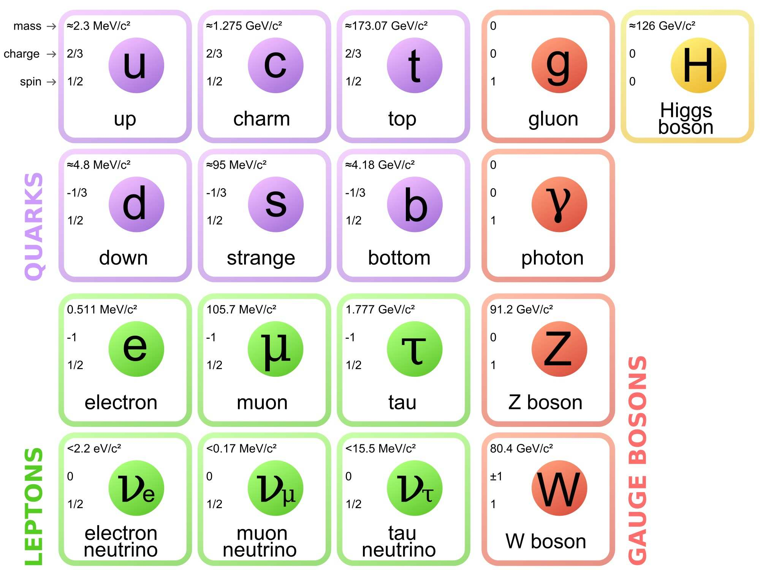
Standard Model of Particle Physics
The Standard Model describes fundamental particles and interactions.
  3 fundamental forces (plus gravity): Electromagnetic, Strong, Weak
  Quarks make up protons, neutrons, and other “hadrons” through strong force.
  Quantum Electrodynamics describes interactions of charged particles (quarks and leptons).
  Leptons also interact with Weak force.
  Gauge Bosons mediate forces.
Early formulation included strict symmetries for electroweak force.
  Lead to incorrect predictions (W&Z!).
  Found to also violate parity and time reversal symmetry
  Became crisis in the field – move on or fix?

Slide 4
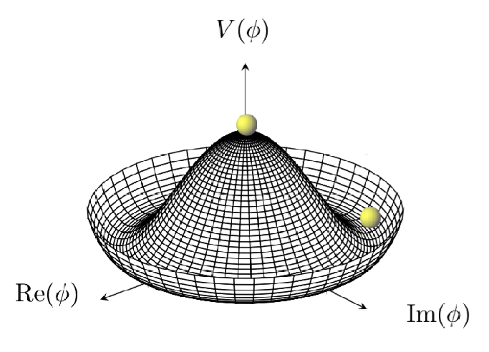
The Brout–Englert–Higgs (BEH) Mechanism
The Higgs field was first theorized in 1964.
  A vital change to field theory – “sombrero” potential spontaneously breaks electroweak symmetry and predicts a (scalar) boson.
  Also explained particle masses through the Yukawa coupling.
  Existence of Higgs boson became major question in particle physics.
Detection was impossible for many years.
  Until the LHC, accelerator energy was too low.
  Process is very rare – need high rates and good detection.

Slide 5
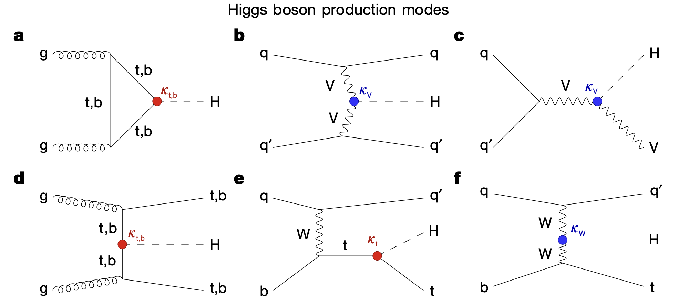
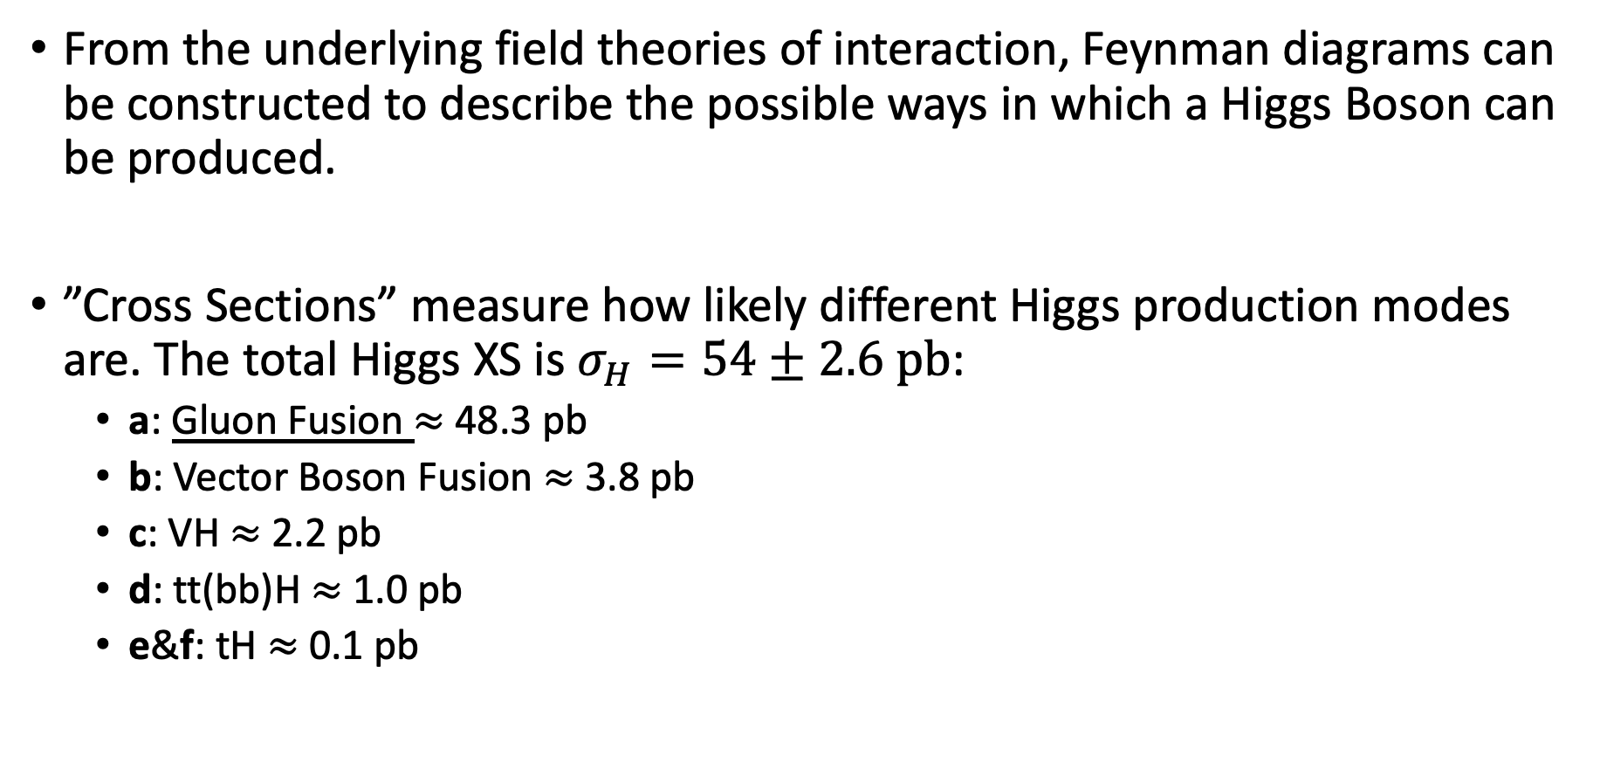
Single Higgs Boson Production Modes
From the underlying field theories of interaction, Feynman diagrams can be constructed to describe the possible ways in which a Higgs Boson can be produced.
”Cross Sections” measure how likely different Higgs production modes are. The total Higgs XS is $σ_{H}=54±2.6 pb$:
  a: Gluon Fusion $≈$ 48.3 pb
  b: Vector Boson Fusion $≈$ 3.8 pb
  c: VH $≈$ 2.2 pb
  d: tt(bb)H $≈$ 1.0 pb
  e&f: tH $≈$ 0.1 pb

Slide 6
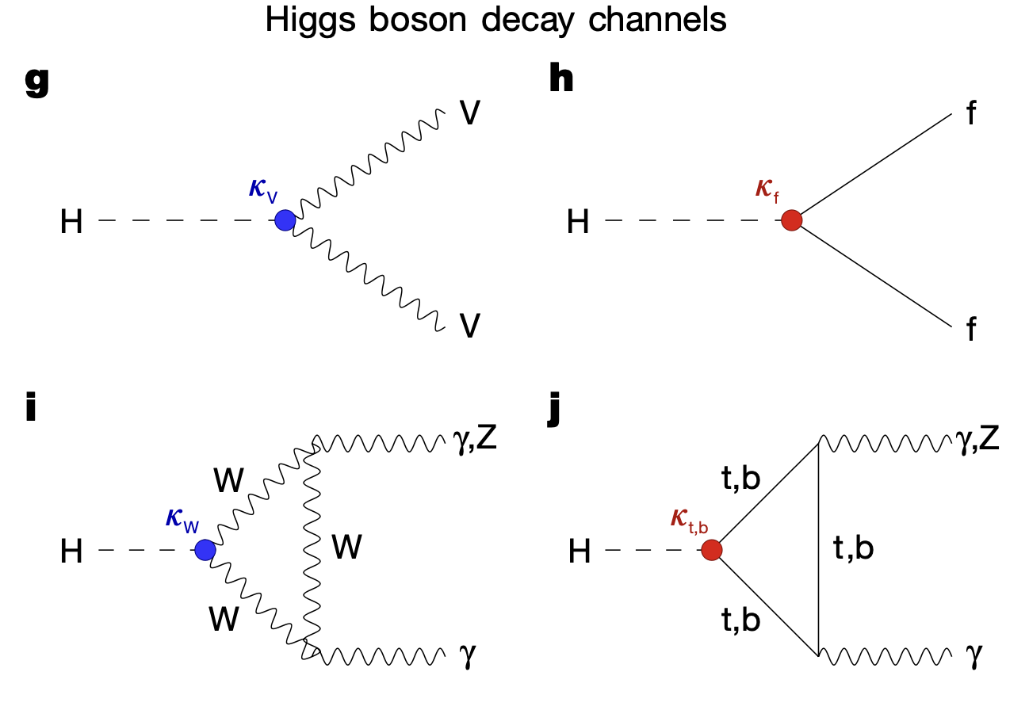

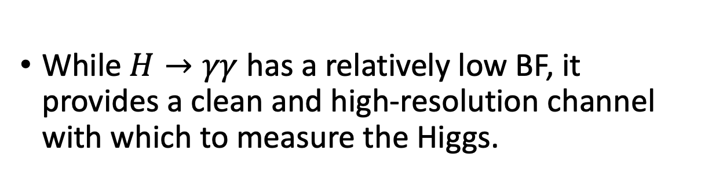
Single Higgs Boson Decay Modes
Regardless of how it is produced, a Higgs boson will decay into one of several allowed final states.
As with production modes, all decays are not equally likely – branching fractions for the Higgs into each mode can be calculated
  g: WW (~22%) and ZZ (~2.7%)
  h: $b\overline{b}$ (~58%), gg (~8%), $ττ$ (~6%) …
  i & j: $γγ$ (~0.2%), 𝑍𝛾 (~0.2%)
While $H→γγ$ has a relatively low BF, it provides a clean and high-resolution channel with which to measure the Higgs.

Slide 7
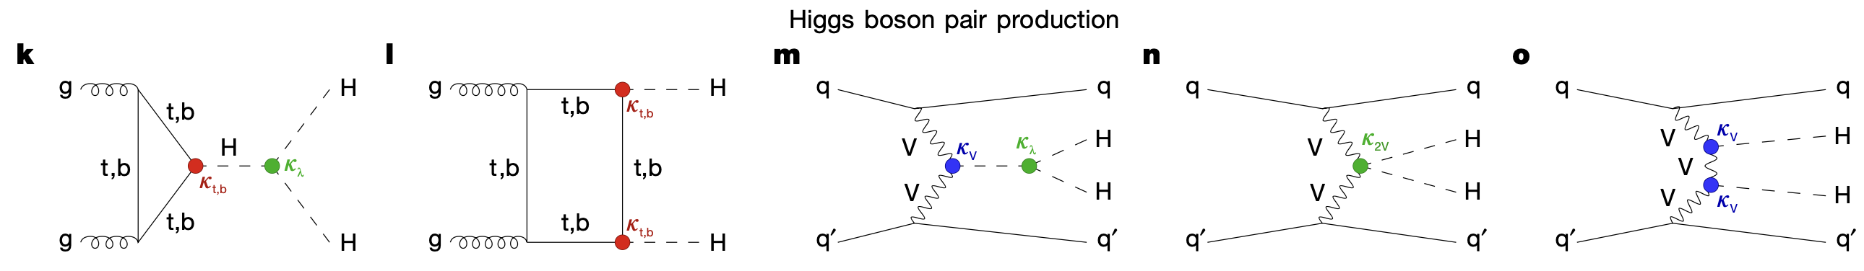
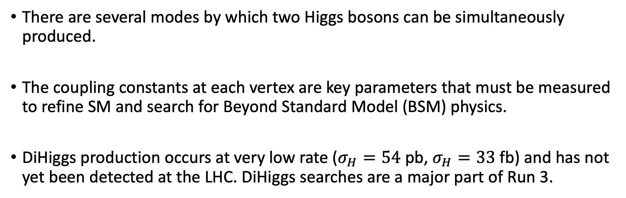
DiHiggs Production Modes
There are several modes by which two Higgs bosons can be simultaneously produced.
The coupling constants at each vertex are key parameters that must be measured to refine SM and search for Beyond Standard Model (BSM) physics.
DiHiggs production occurs at very low rate ($σ_{H}=54$ pb, $σ_{H}=33$ fb) and has not yet been detected at the LHC. DiHiggs searches are a major part of Run 3.

Slide 8
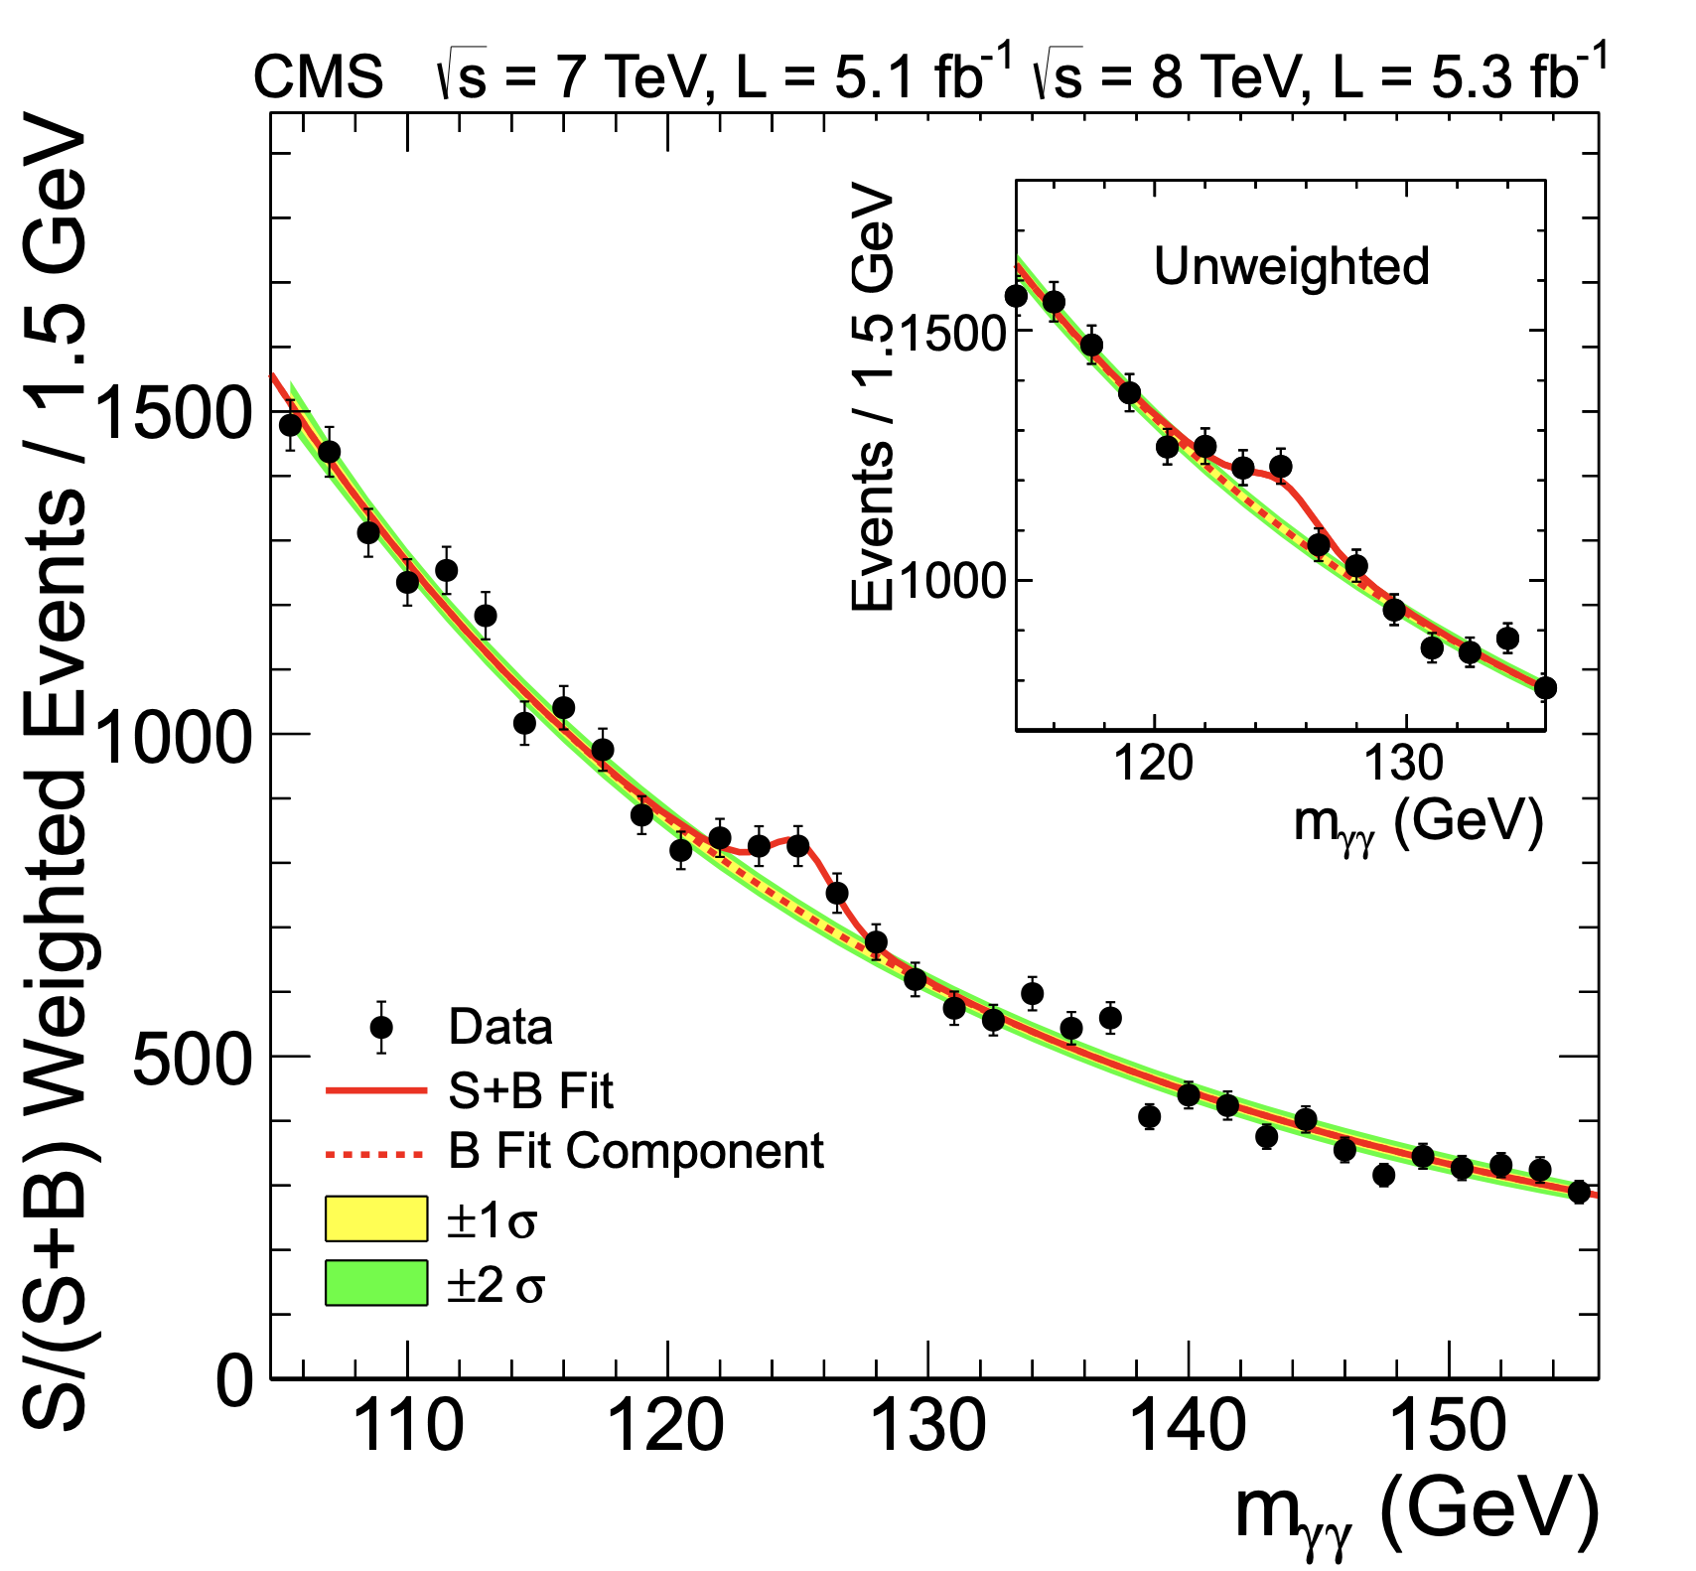
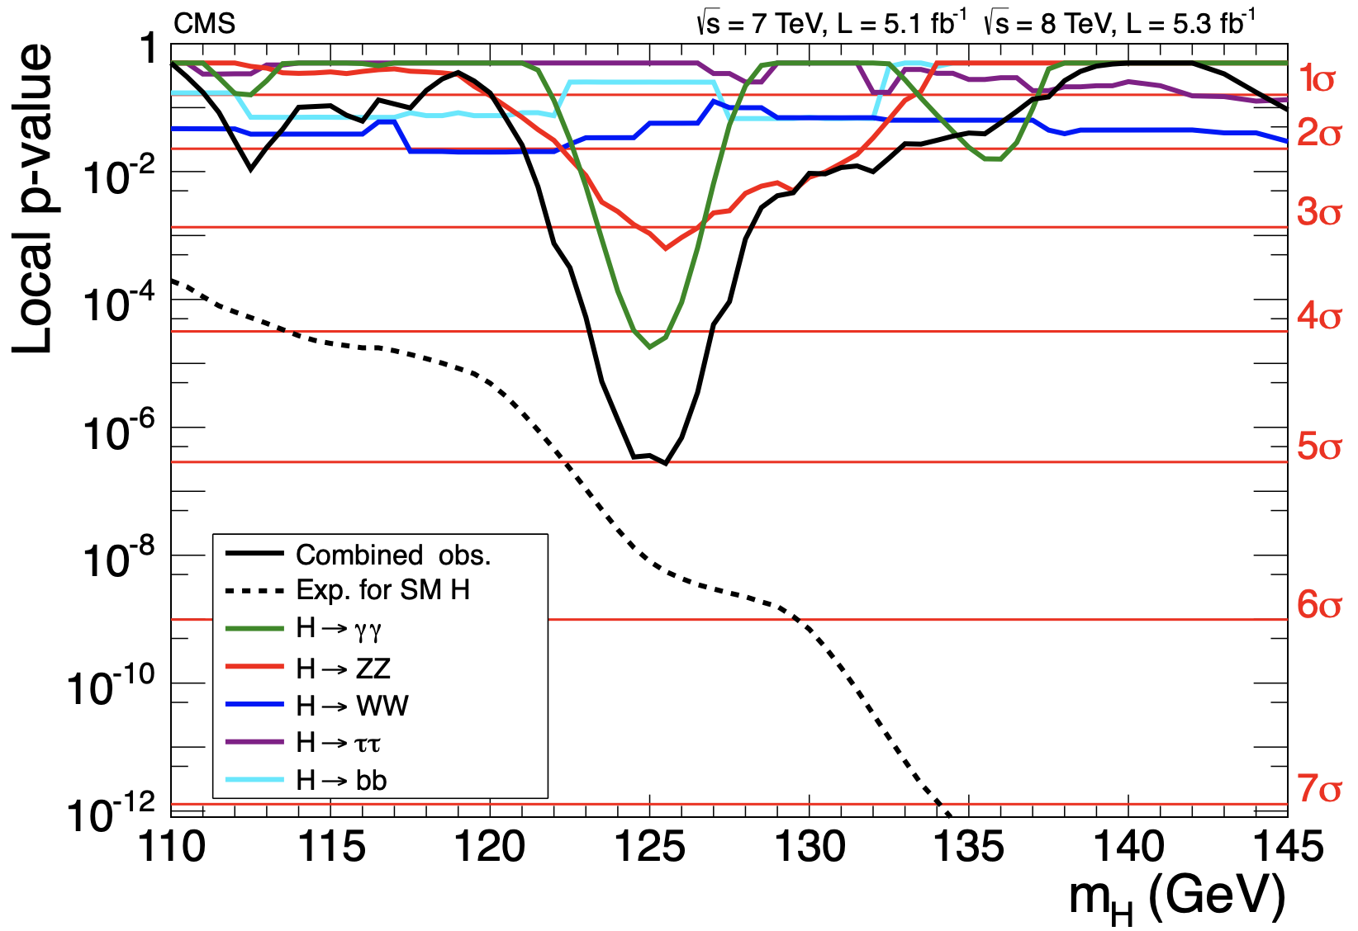
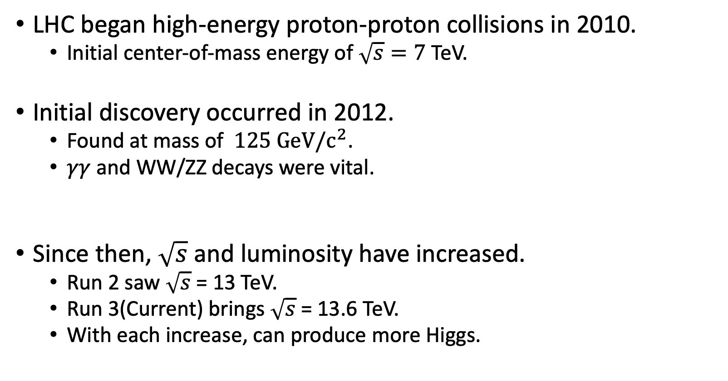
Higgs Discovery
LHC began high-energy proton-proton collisions in 2010.
  Initial center-of-mass energy of $\sqrt{s}=7$TeV.
Initial discovery occurred in 2012.
  Found at mass of $125 GeV/c^{2}$.
  $γγ$ and WW/ZZ decays were vital.
Since then, $\sqrt{s}$ and luminosity have increased.
  Run 2 saw $\sqrt{s}$ = 13 TeV.
  Run 3(Current) brings $\sqrt{s}$ = 13.6 TeV.
  With each increase, can produce more Higgs.

Slide 9
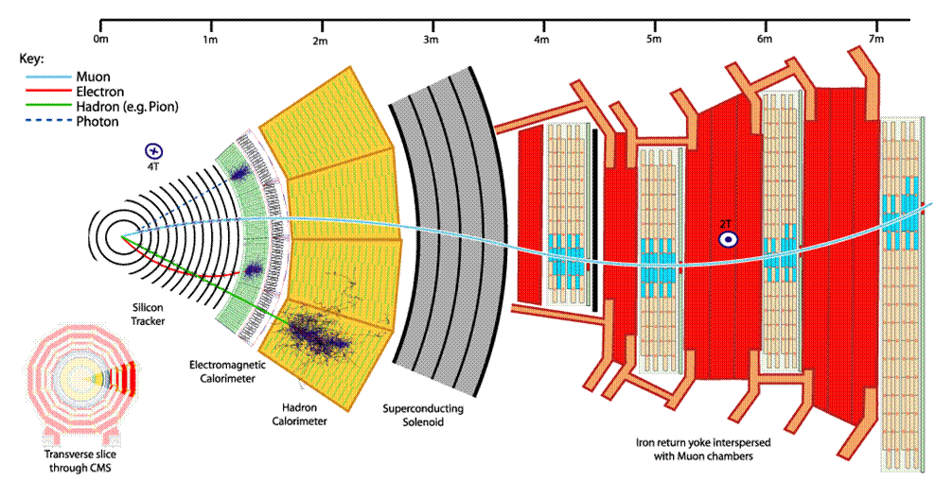
CMS Detector
CMS has several layers of detector elements:
  Silicon pixels and strips give spatial tracking information.
  Calorimeters measure energy deposition in different areas.
    Electromagnetic calorimeter(ECAL) measures electrons and photons.
    Hadron calorimeter(HCAL) detects hadronic particles.
  3.8T Solenoid provides strong magnetic field for inner detector.
  Muon chambers (Drift Tubes)
  Scintillators and “RPCs” for triggering

Slide 10
Triggering at CMS
Run 3 bunch crossings occur at 40 MHz (every 25 ns)
  Each bunch crossing contains an average of 57 collisions (termed pileup)
Two-tiered triggering system is designed to reduce rate to a level that can be read out, processed and stored
Hardware-based Level 1 (L1) trigger takes raw detector inputs and reduces rate to ~110 kHz.
Software-based High-Level Trigger (HLT) processes outputs from L1, performs event reconstruction, and selects just 7 kHz of events to save.
  Each event is ~ 1 MB, so storage load is still huge

Slide 11
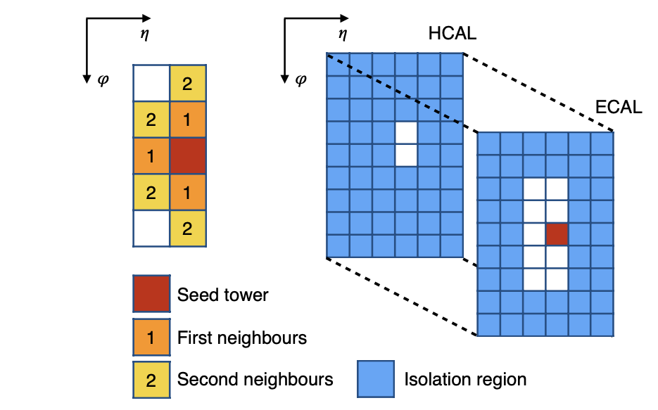
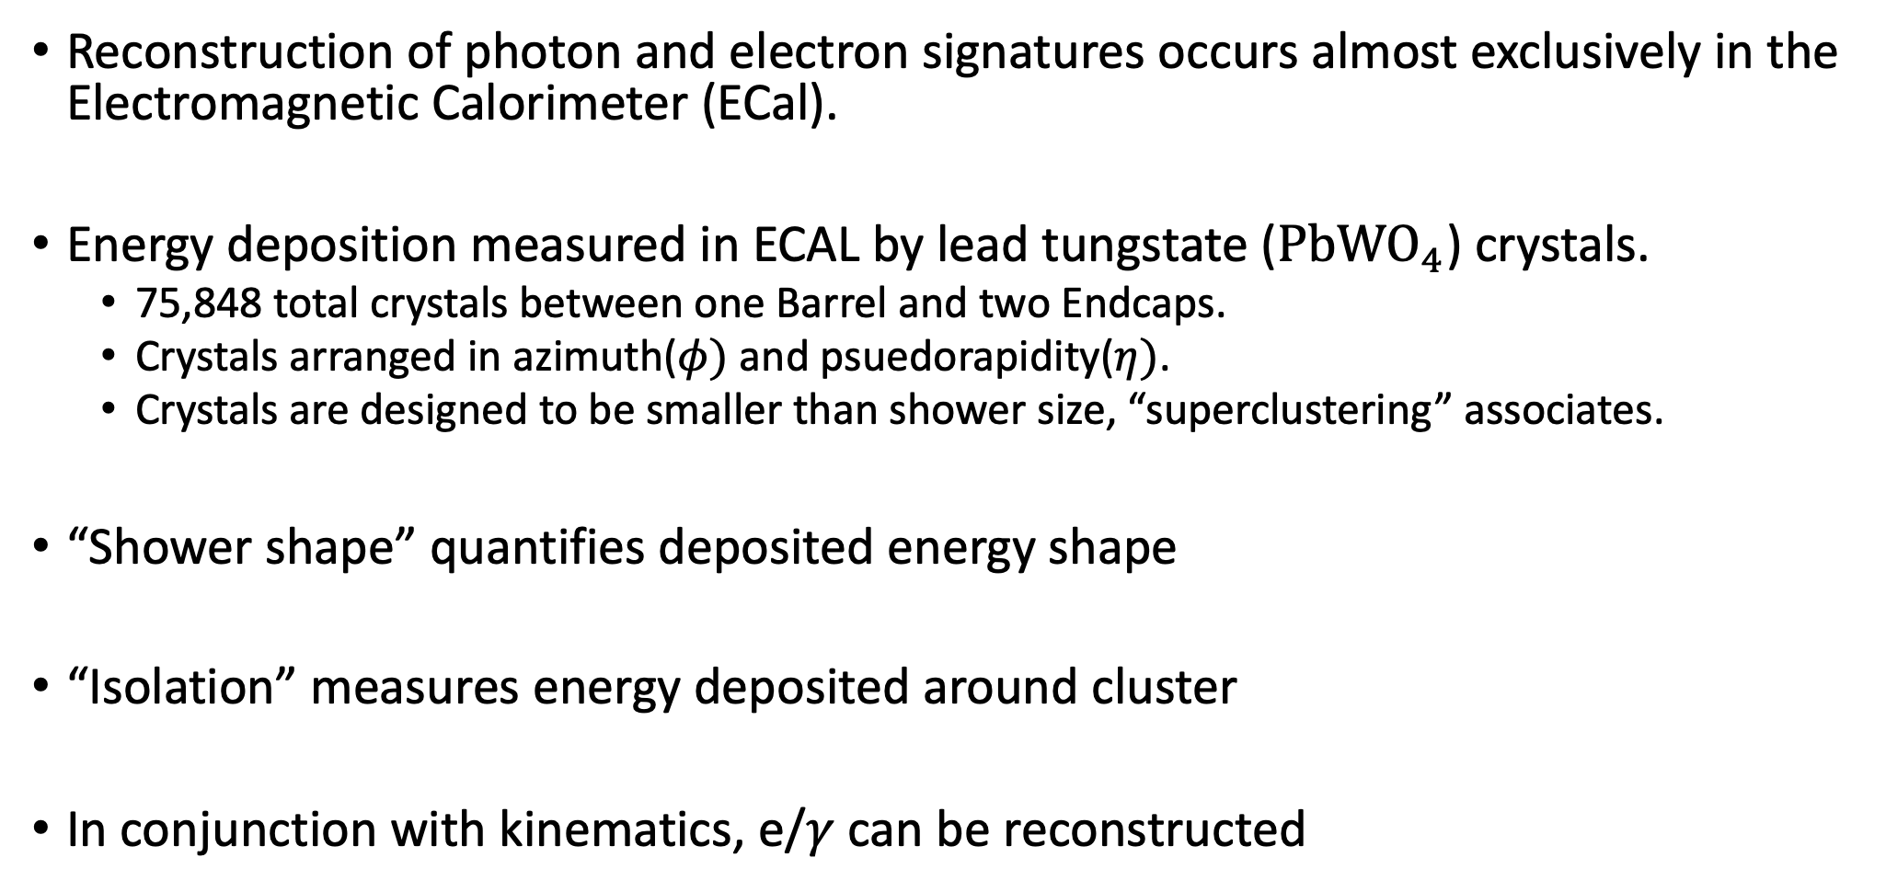

e/$γ$ Event Reconstruction at CMS
Reconstruction of photon and electron signatures occurs almost exclusively in the Electromagnetic Calorimeter (ECal).
Energy deposition measured in ECAL by lead tungstate ($PbWO_{4}$) crystals.
  75,848 total crystals between one Barrel and two Endcaps.
  Crystals arranged in azimuth($φ)$ and psuedorapidity($η)$.
  Crystals are designed to be smaller than shower size, “superclustering” associates.
“Shower shape” quantifies deposited energy shape
“Isolation” measures energy deposited around cluster
In conjunction with kinematics, e/$γ$ can be reconstructed

Slide 12
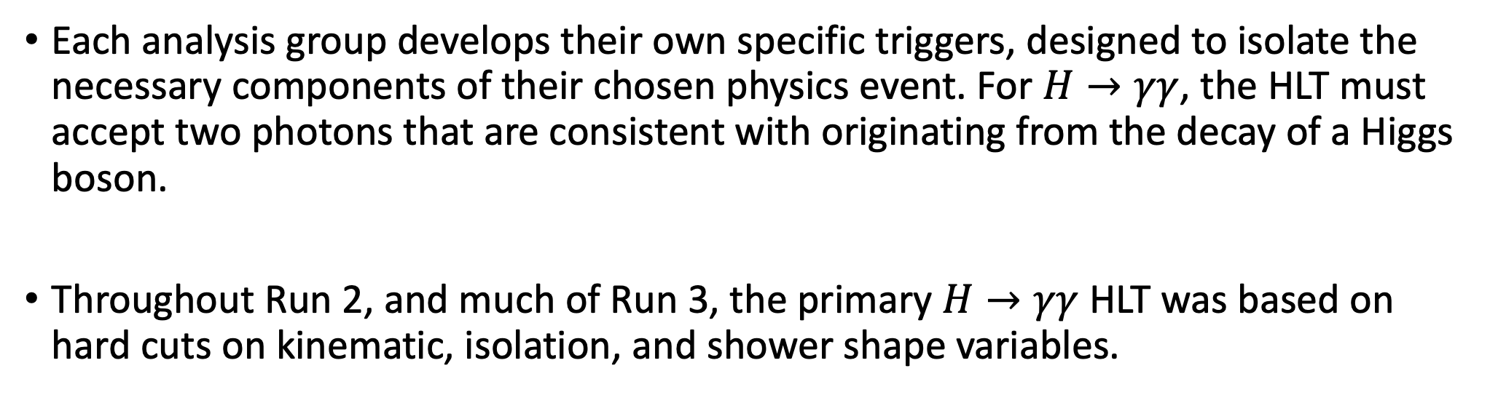

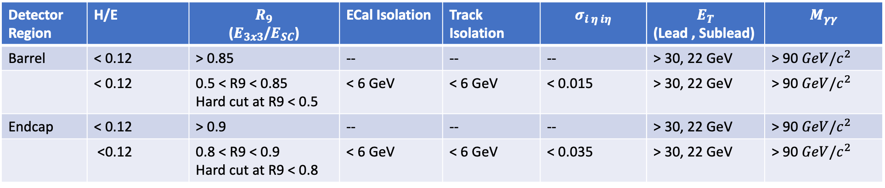
The Standard $H→γγ$ HLT (sHLT)
Each analysis group develops their own specific triggers, designed to isolate the necessary components of their chosen physics event. For $H→γγ$, the HLT must accept two photons that are consistent with originating from the decay of a Higgs boson.
Throughout Run 2, and much of Run 3, the primary $H→γγ$ HLT was based on hard cuts on kinematic, isolation, and shower shape variables.
Detector Region | H/E | $$R_{9}$$ ($E_{3x3}$/$E_{SC}$) | ECal Isolation | Track Isolation | $$σ_{i η iη}$$ | $$E_{T}$$ (Lead , Sublead) | $$M_{γγ}$$
Barrel | < 0.12 | > 0.85 | -- | -- | -- | > 30, 22 GeV | > 90 $GeV/c^{2}$
 | < 0.12 | 0.5 < R9 < 0.85 Hard cut at R9 < 0.5 | < 6 GeV | < 6 GeV | < 0.015 | > 30, 22 GeV | > 90 $GeV/c^{2}$
Endcap | < 0.12 | > 0.9 | -- | -- | -- | > 30, 22 GeV | > 90 $GeV/c^{2}$
 | <0.12 | 0.8 < R9 < 0.9 Hard cut at R9 < 0.8 | < 6 GeV | < 6 GeV | < 0.035 | > 30, 22 GeV | > 90 $GeV/c^{2}$

Slide 13
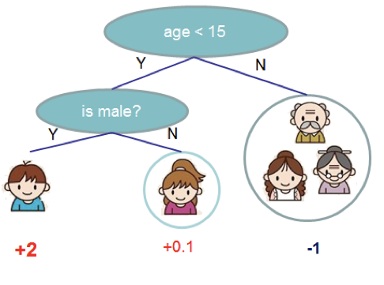
Boosted Decision Trees
A Boosted Decision Tree (BDT) is a Machine Learning technique where “ensembles” of simple decision trees are combined to process high-dimensional data.
Since the HLT is a binary classification problem (signal vs background), BDTs are an obvious approach.
Each tree operates on subsets of the available input variables, assigning weights at each ”node” to build up a complex decision tree.
Our BDTs will use shower shape and isolation variables.

Slide 14
Development of a BDT-Based High-Level Trigger (MVA-HLT)

Slide 15
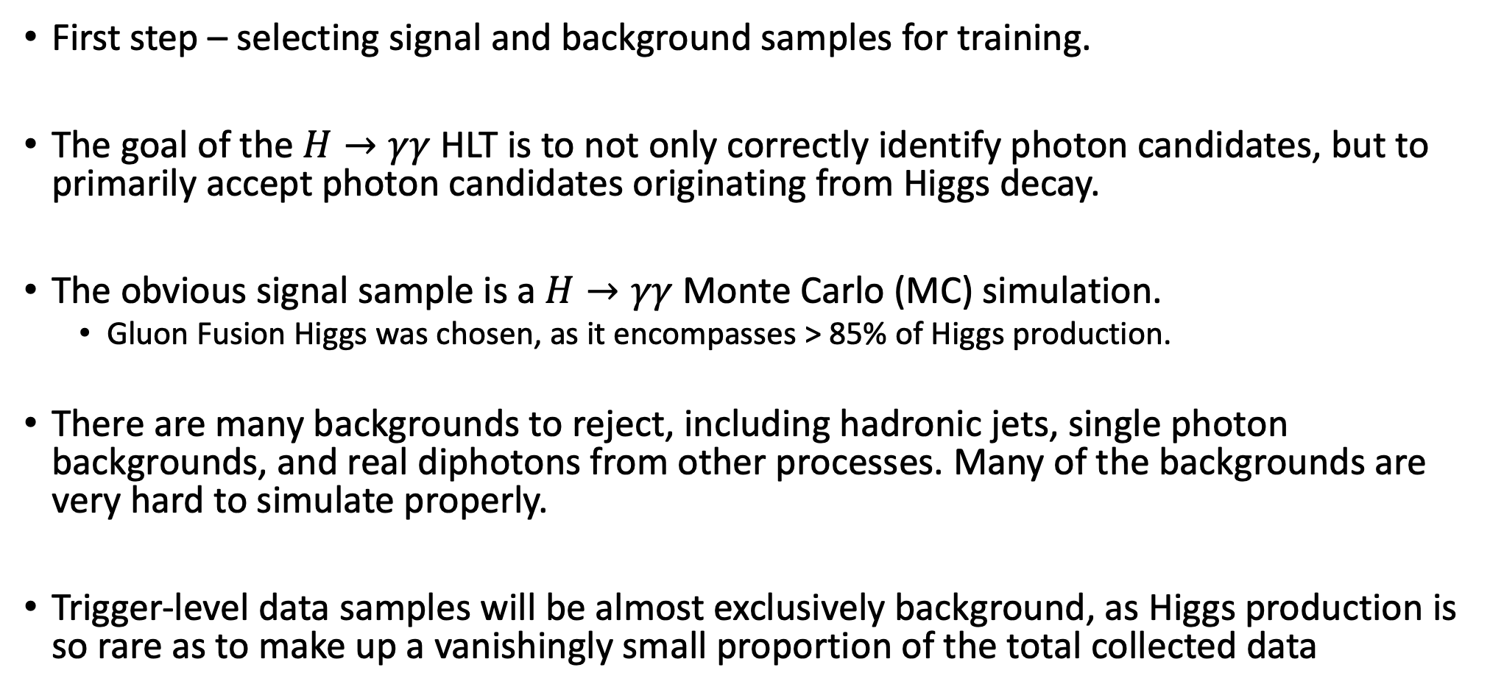
Training Samples for a Trigger-Level Diphoton BDT
First step – selecting signal and background samples for training.
The goal of the $H→γγ$ HLT is to not only correctly identify photon candidates, but to primarily accept photon candidates originating from Higgs decay.
The obvious signal sample is a $H→γγ$ Monte Carlo (MC) simulation.
  Gluon Fusion Higgs was chosen, as it encompasses > 85% of Higgs production.
There are many backgrounds to reject, including hadronic jets, single photon backgrounds, and real diphotons from other processes. Many of the backgrounds are very hard to simulate properly.
Trigger-level data samples will be almost exclusively background, as Higgs production is so rare as to make up a vanishingly small proportion of the total collected data

Slide 16
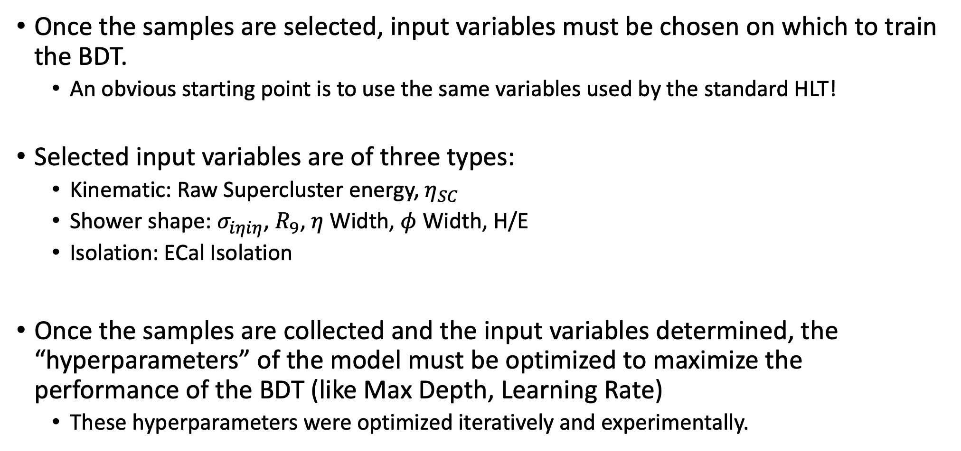
Training a Trigger-Level Diphoton BDT
Once the samples are selected, input variables must be chosen on which to train the BDT.
  An obvious starting point is to use the same variables used by the standard HLT!
Selected input variables are of three types:
  Kinematic: Raw Supercluster energy, $η_{SC}$
  Shower shape: $σ_{iηiη}$, $R_{9}$, $η$ Width, $φ$ Width, H/E
  Isolation: ECal Isolation
Once the samples are collected and the input variables determined, the “hyperparameters” of the model must be optimized to maximize the performance of the BDT (like Max Depth, Learning Rate)
  These hyperparameters were optimized iteratively and experimentally.

Slide 17
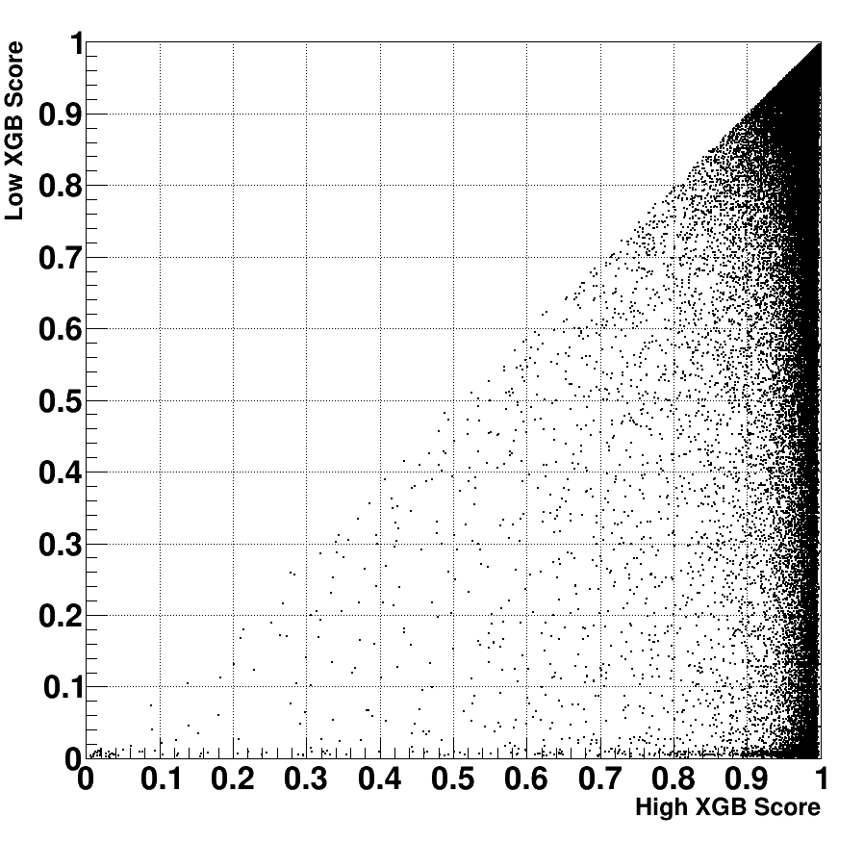
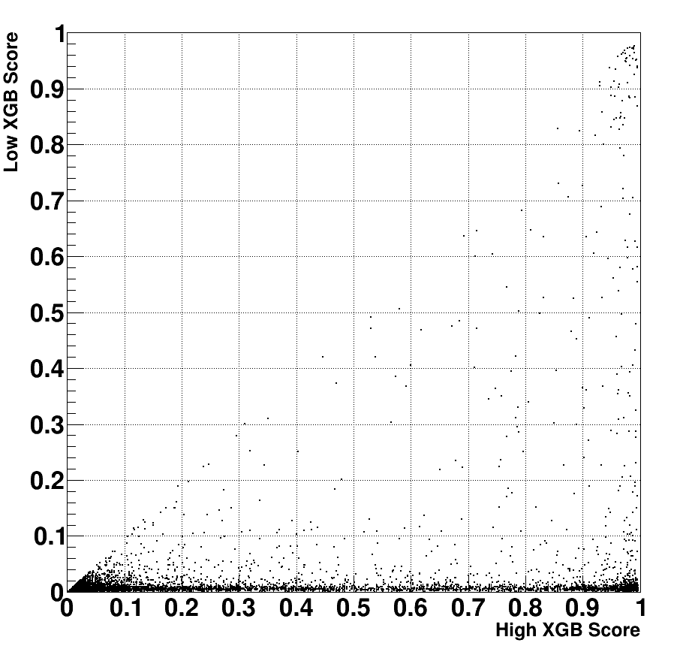
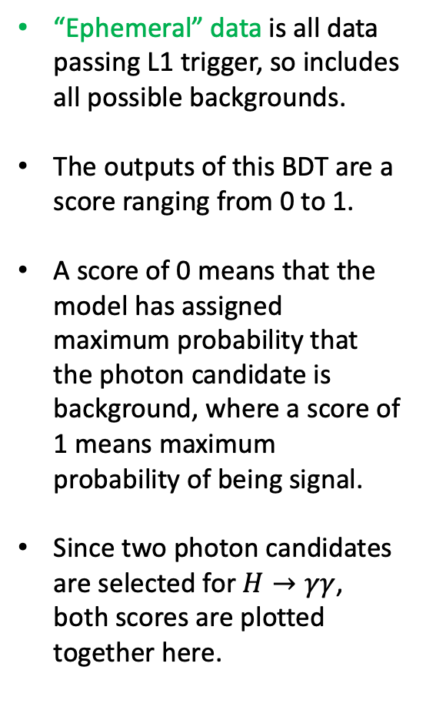
Output Trigger-Level Score Distributions
Higgs MC Signal
“Ephemeral” Data
“Ephemeral” data is all data passing L1 trigger, so includes all possible backgrounds.
The outputs of this BDT are a score ranging from 0 to 1.
A score of 0 means that the model has assigned maximum probability that the photon candidate is background, where a score of 1 means maximum probability of being signal.
Since two photon candidates are selected for $H→γγ$, both scores are plotted together here.
Clearly, the signal usually has one (or both) candidate scores near 1.
Meanwhile, most data events have one (or both) candidate scores near 0.

Slide 18
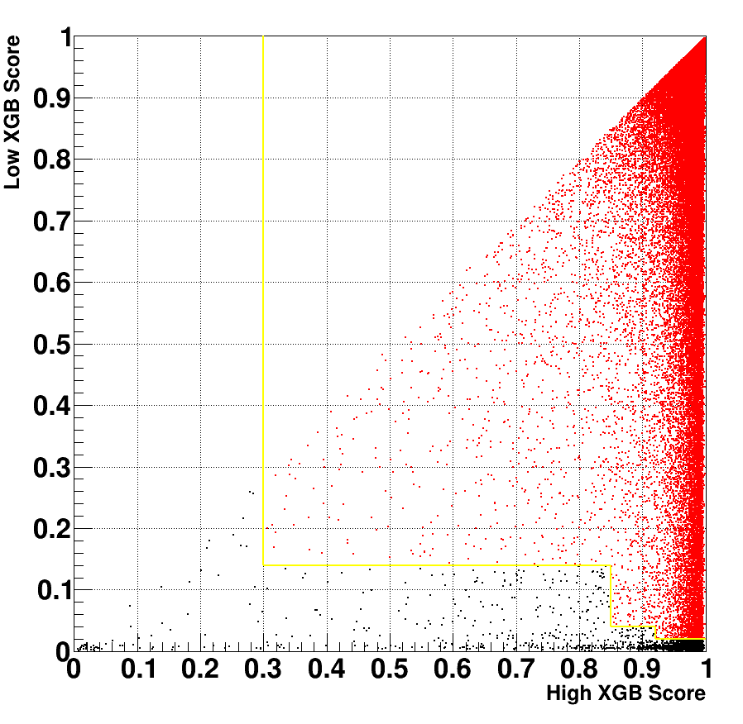
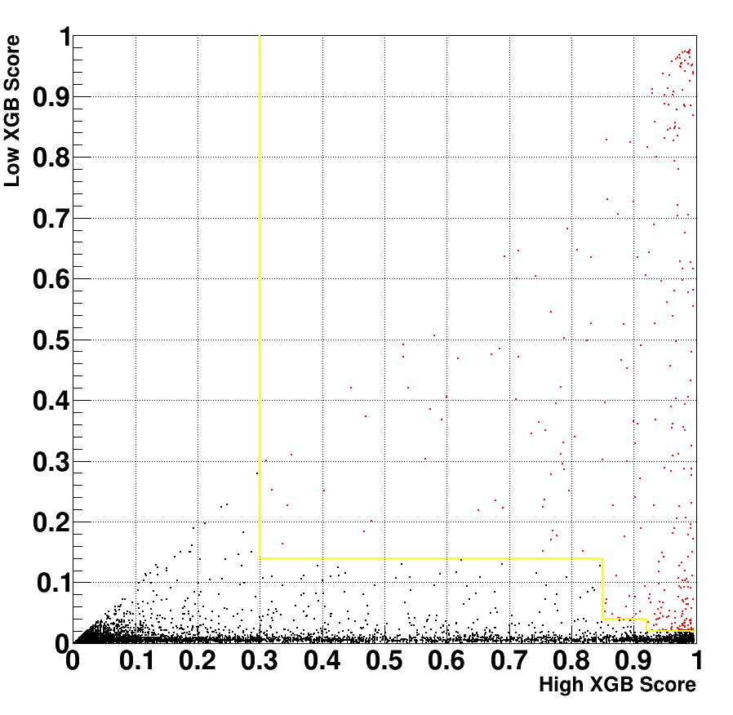
Selection of BDT Score Cuts for MVA-HLT
Higgs MC Signal
“Ephemeral” Data
Cuts (in yellow) are chosen to select as many signal MC events as possible while keeping the data rate low.
“Step” pattern shows conditional cuts – one photon with a very high score requires a lower score cut on the second photon.
This structure allows many events with one very high-quality photon to be preserved in the signal MC.
Some signal losses occur due to having a second photon with a very low score.
Very little data is accepted – This selection has a much lower rate (29.4 Hz) than the standard HLT (61.5 Hz).

Slide 19
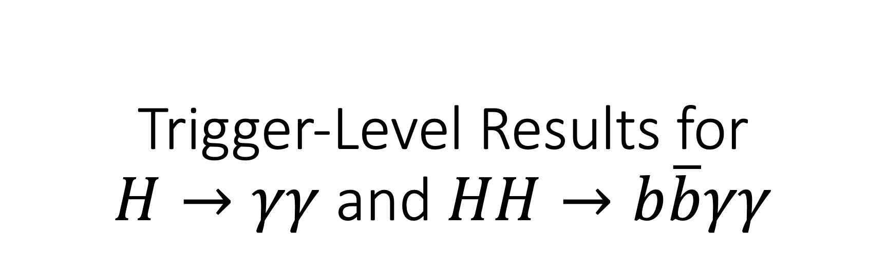
Trigger-Level Results for
$H→γγ$ and $HH→b\overline{b}γγ$

Slide 20
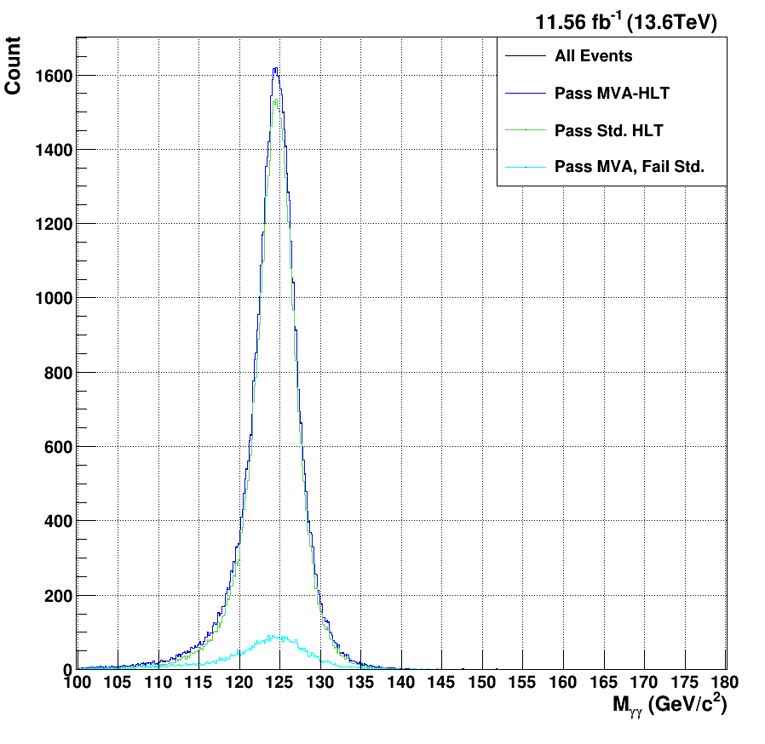
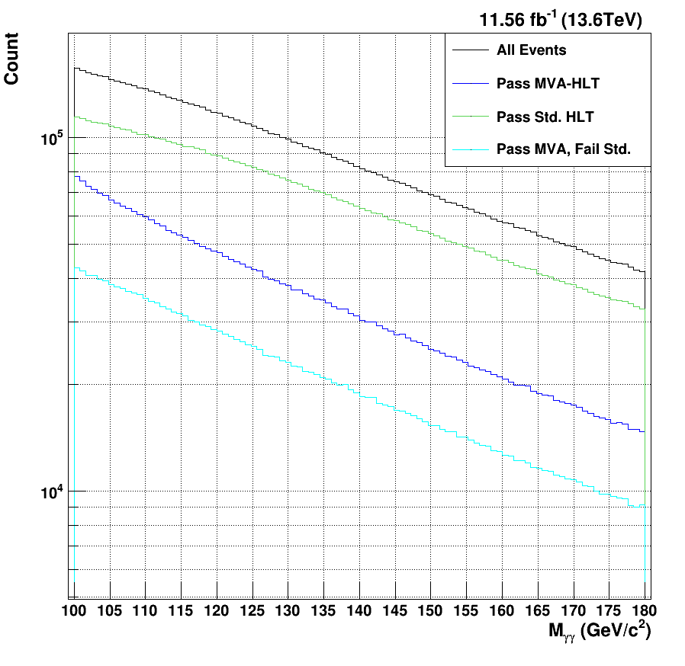

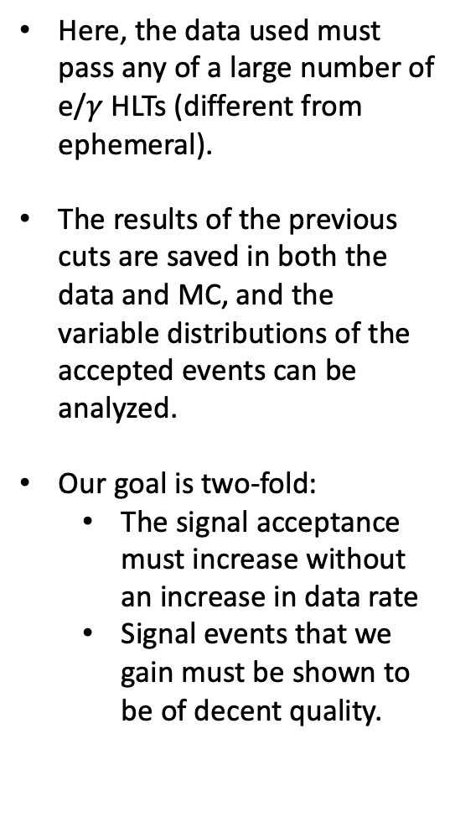
Single Higgs $M_{γγ}$
Higgs MC Signal
Data
Here, the data used must pass any of a large number of e/$γ$ HLTs (different from ephemeral).
The results of the previous cuts are saved in both the data and MC, and the variable distributions of the accepted events can be analyzed.
Our goal is two-fold:
  The signal acceptance must increase without an increase in data rate
  Signal events that we gain must be shown to be of decent quality.
Much of the gain from our selection occurs within the mass peak.
The signal efficiency of our selection (97.3%) is improved relative to the sHLT (88.7%).
The data rate is considerably lower for our selection (~47% relative reduction in rate).

Slide 21
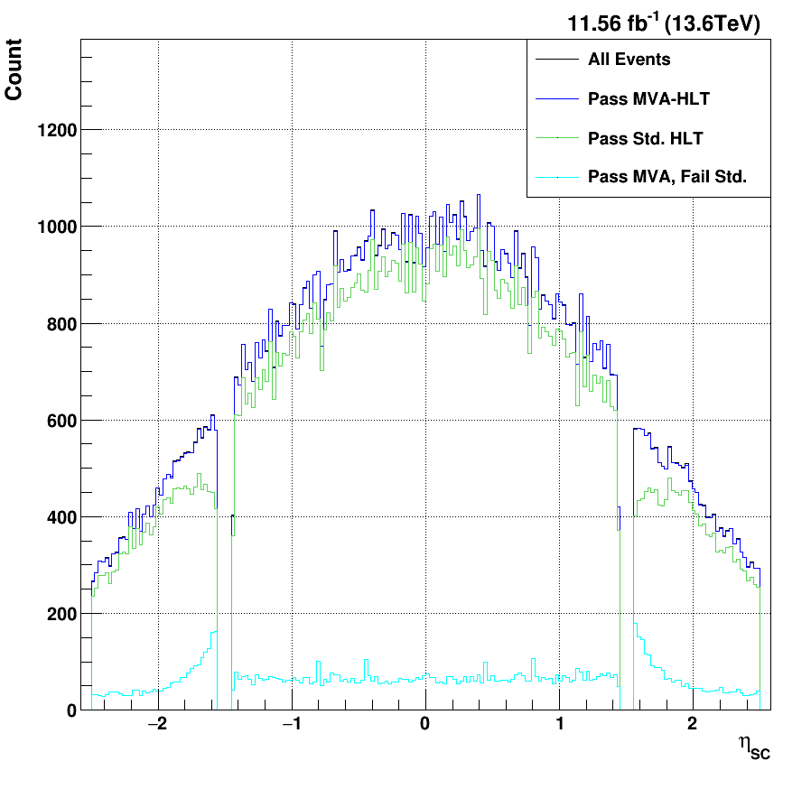
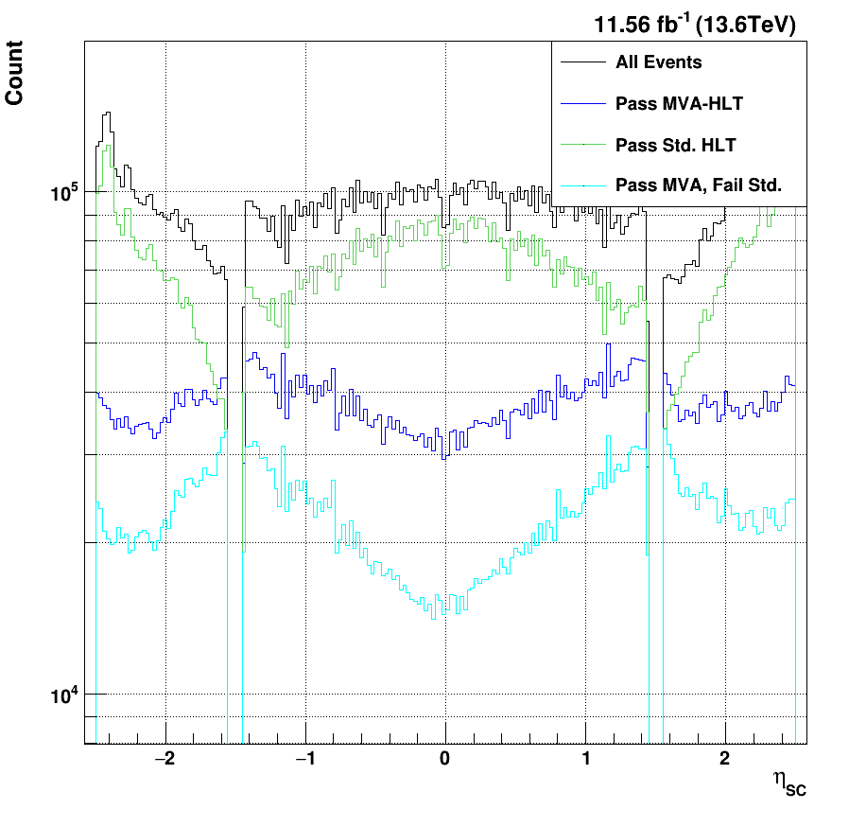

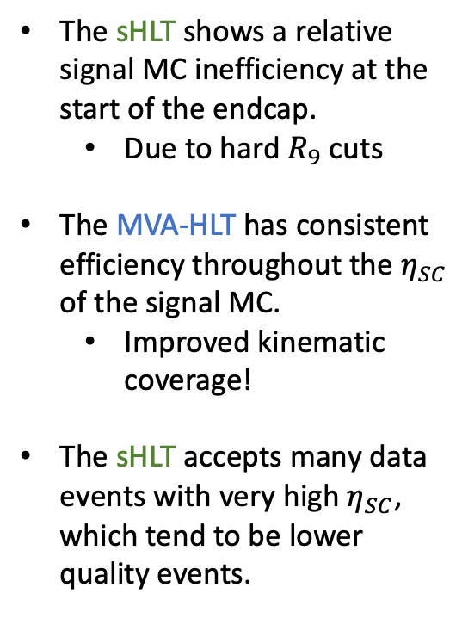
Single Higgs $η_{SC}$
Higgs MC Signal
Data
The sHLT shows a relative signal MC inefficiency at the start of the endcap.
  Due to hard $R_{9}$ cuts
The MVA-HLT has consistent efficiency throughout the $η_{SC}$ of the signal MC.
  Improved kinematic coverage!
The sHLT accepts many data events with very high $η_{SC}$, which tend to be lower quality events.
The MVA-HLT improves the kinematic coverage in $η_{SC}$ relative to the sHLT.

Slide 22
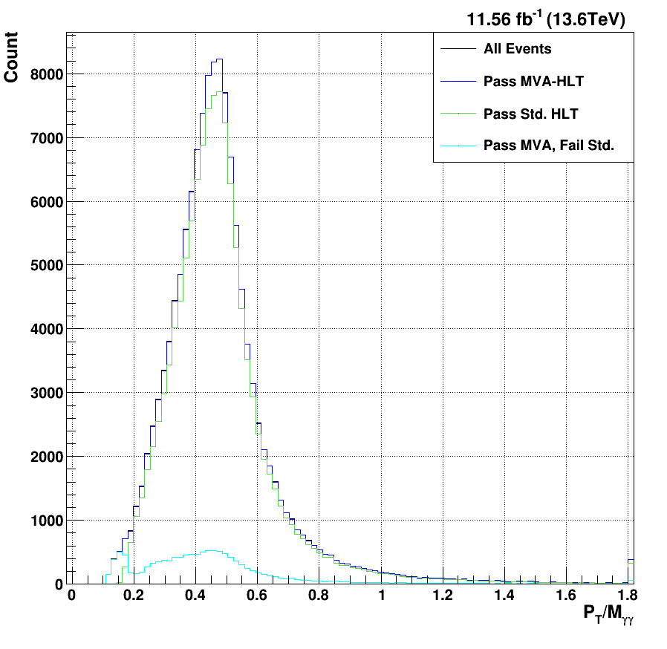
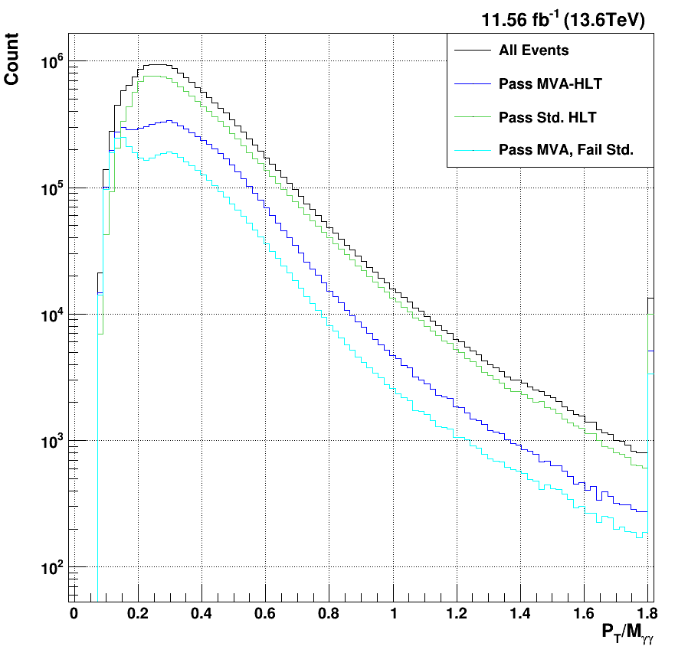

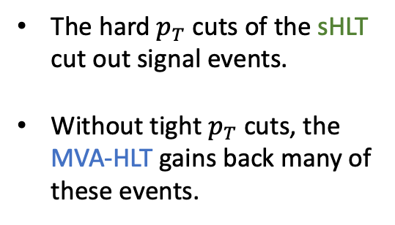
Single Higgs $p_{T}$/$M_{γγ}$
Higgs MC Signal
Data
The hard $p_{T}$ cuts of the sHLT cut out signal events.
Without tight $p_{T}$ cuts, the MVA-HLT gains back many of these events.
The MVA-HLT improves the kinematic coverage in $p_{T}$/$M_{γγ}$ relative to the sHLT.

Slide 23
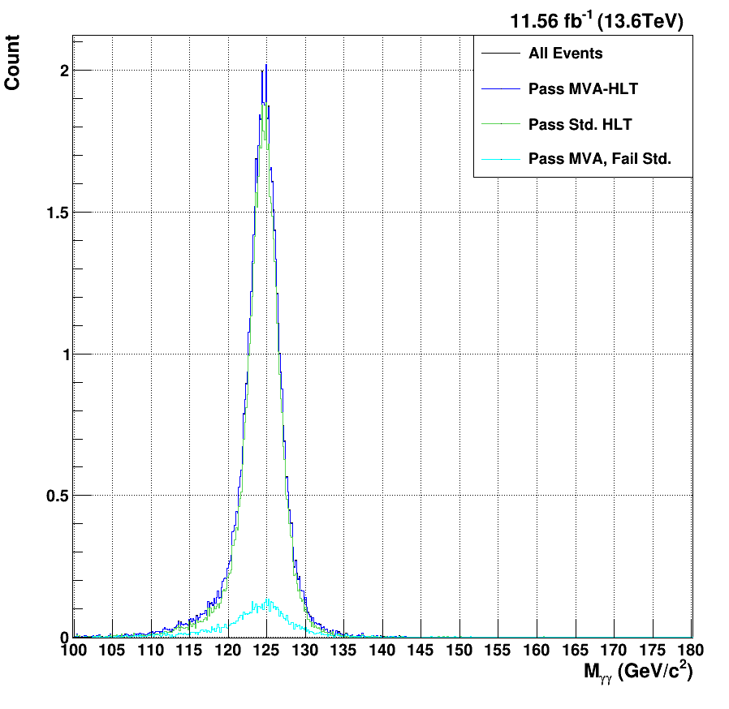
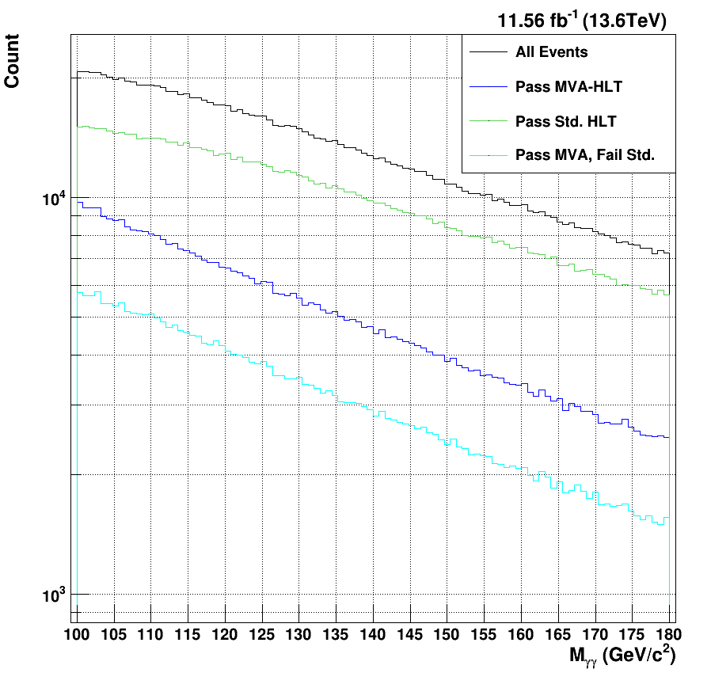

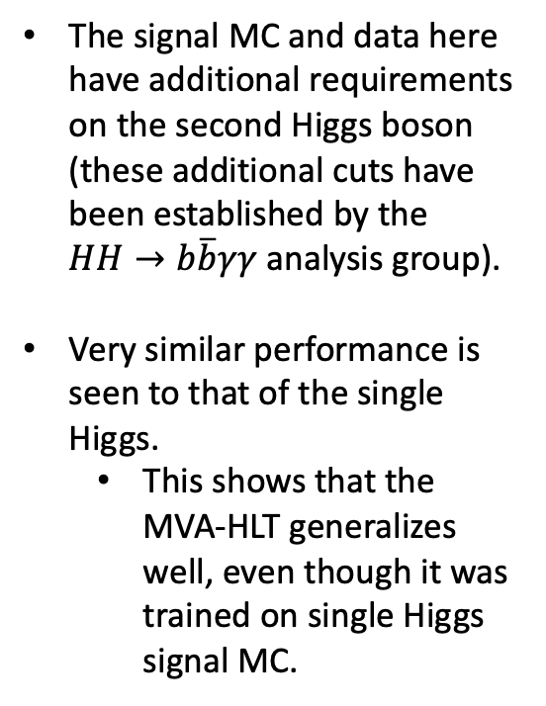
DiHiggs $M_{γγ}$
DiHiggs MC Signal
Data
The signal MC and data here have additional requirements on the second Higgs boson (these additional cuts have been established by the $HH→b\overline{b}γγ$ analysis group).
Very similar performance is seen to that of the single Higgs.
  This shows that the MVA-HLT generalizes well, even though it was trained on single Higgs signal MC.
The signal efficiency of the MVA-HLT (98.5%) is higher than that of the sHLT (88.5%).
The MVA-HLT generalizes well to the $HH→b\overline{b}γγ$ sample.

Slide 24
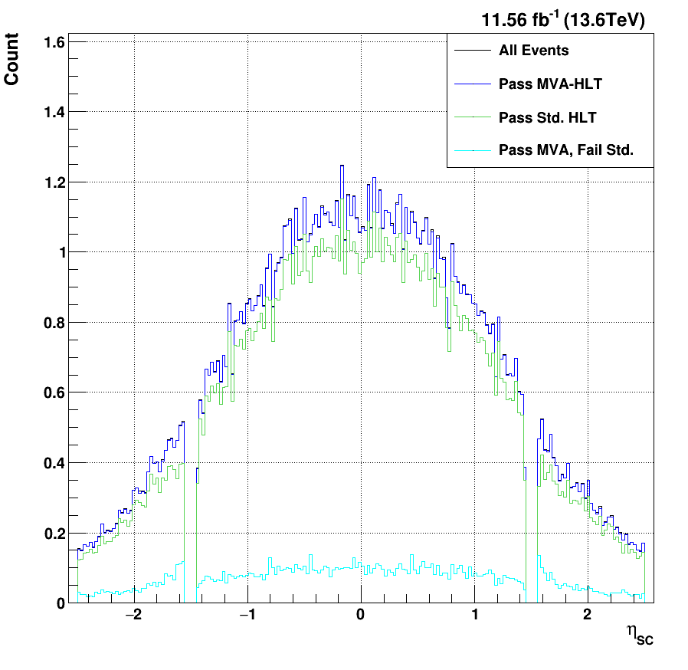
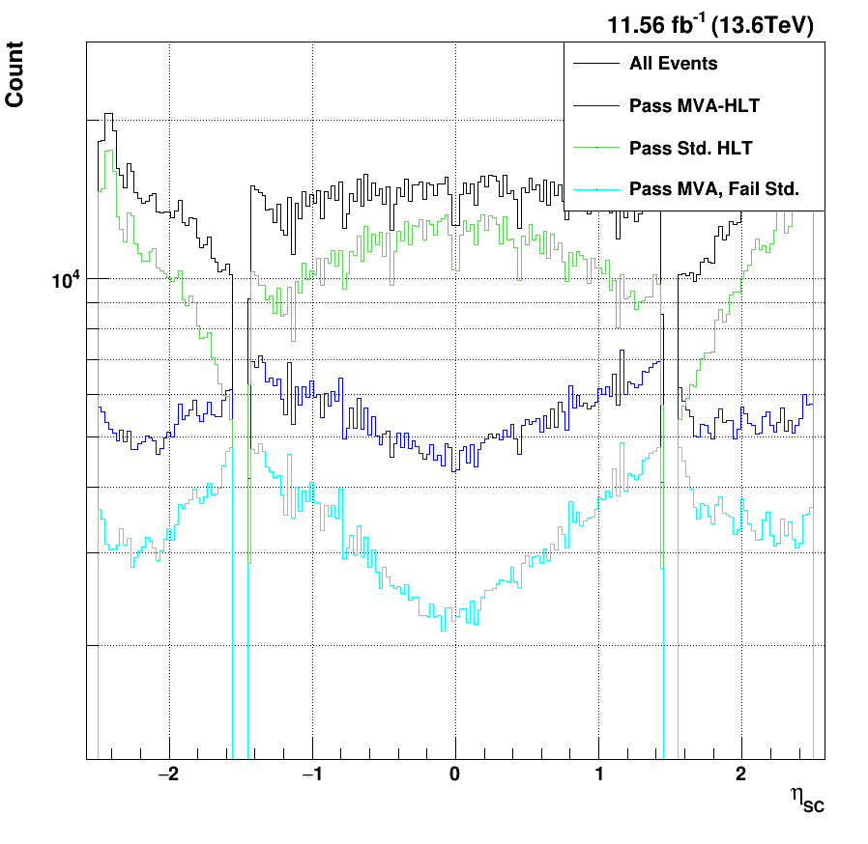

DiHiggs $η_{SC}$
DiHiggs MC Signal
Data
Similar improvements to the kinematic coverage can be seen for the DiHiggs sample.

Slide 25
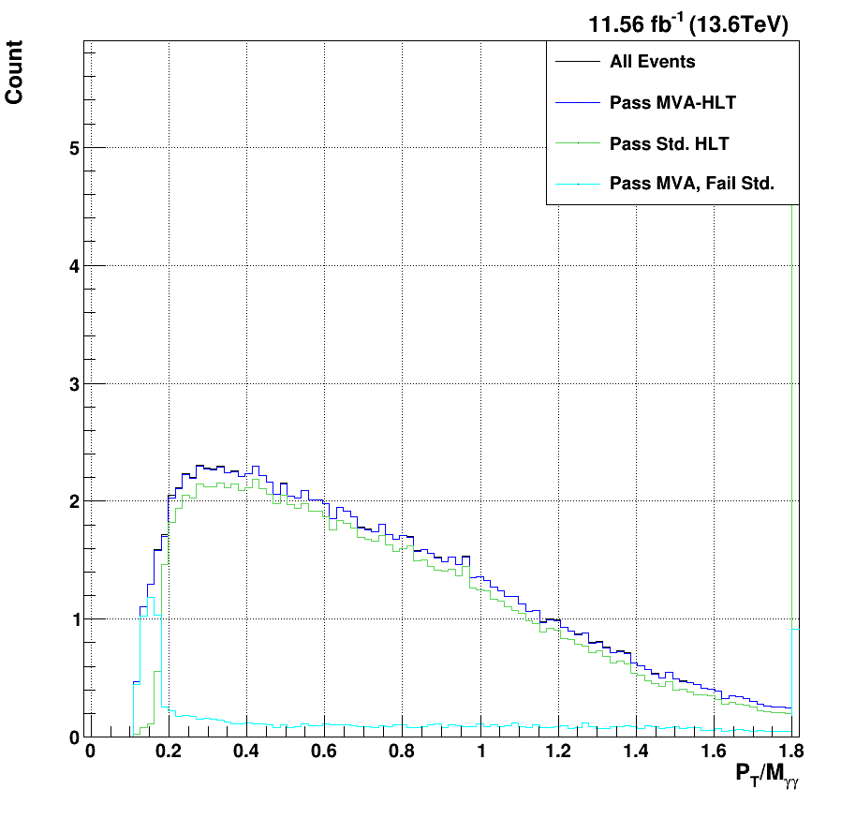
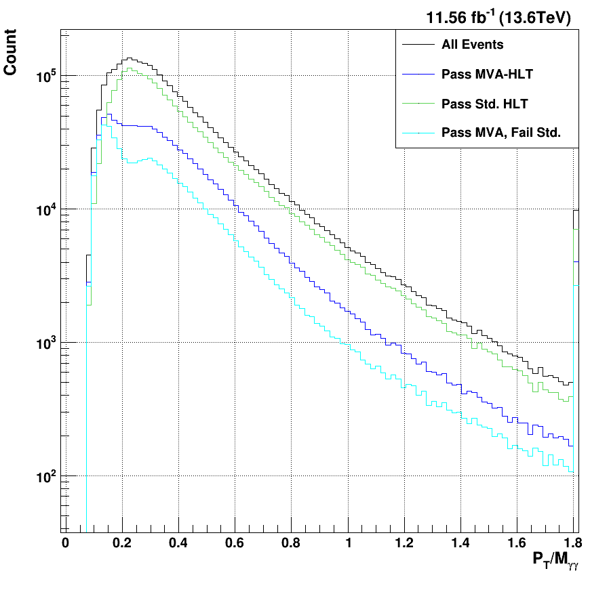

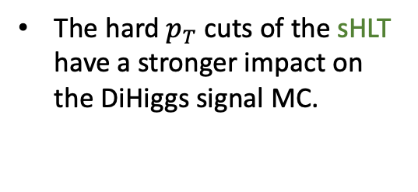
DiHiggs $p_{T}$/$M_{γγ}$
DiHiggs MC Signal
Data
The hard $p_{T}$ cuts of the sHLT have a stronger impact on the DiHiggs signal MC.
The MVA-HLT is able to gain more signal events at lower $p_{T}$/$M_{γγ}$.

Slide 26
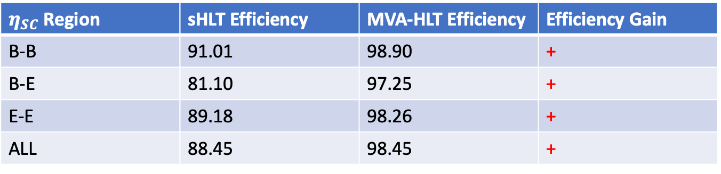
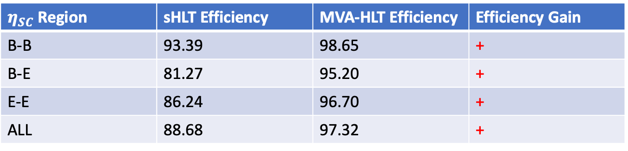
Trigger-Level Efficiency Summary
Single Higgs
The total signal efficiency gain is appreciable for both the single Higgs and DiHiggs MC samples.
In both cases, this accompanies a much lower trigger rate.
So, the MVA-HLT is able to accept fewer data events overall, while still accepting more signal events. This will lead to an overall improvement to the signal purity of the data.
$η_{SC}$ Region | sHLT Efficiency | MVA-HLT Efficiency | Efficiency Gain
B-B | 93.39 | 98.65 | +
B-E | 81.27 | 95.20 | +
E-E | 86.24 | 96.70 | +
ALL | 88.68 | 97.32 | +
DiHiggs
$η_{SC}$ Region | sHLT Efficiency | MVA-HLT Efficiency | Efficiency Gain
B-B | 91.01 | 98.90 | +
B-E | 81.10 | 97.25 | +
E-E | 89.18 | 98.26 | +
ALL | 88.45 | 98.45 | +

Slide 27
Development of a BDT-Based Offline Selection Optimized in Conjunction with the MVA-HLT

Slide 28
Principles of the Offline Analysis
The HLT is primarily designed to reduce the overall data processing rate while preserving as many important signal events as possible.
Physics analysis and measurements occur after the HLT is applied to the data, when these samples are processed and final “offline selections” are applied to the events passing the trigger.
The HLT-level cuts are designed to mirror the eventual offline analysis cuts.
  Due to improved reconstruction and corrections, the offline analysis cuts are designed to be tighter than the HLT cuts.
In order to leverage the gains made by the MVA-HLT, a new offline selection must be developed with a similarly high signal efficiency.
  As with the Standard Analysis (SA) cuts and the sHLT, this new selection should be constructed on similar principles to the MVA-HLT.

Slide 29
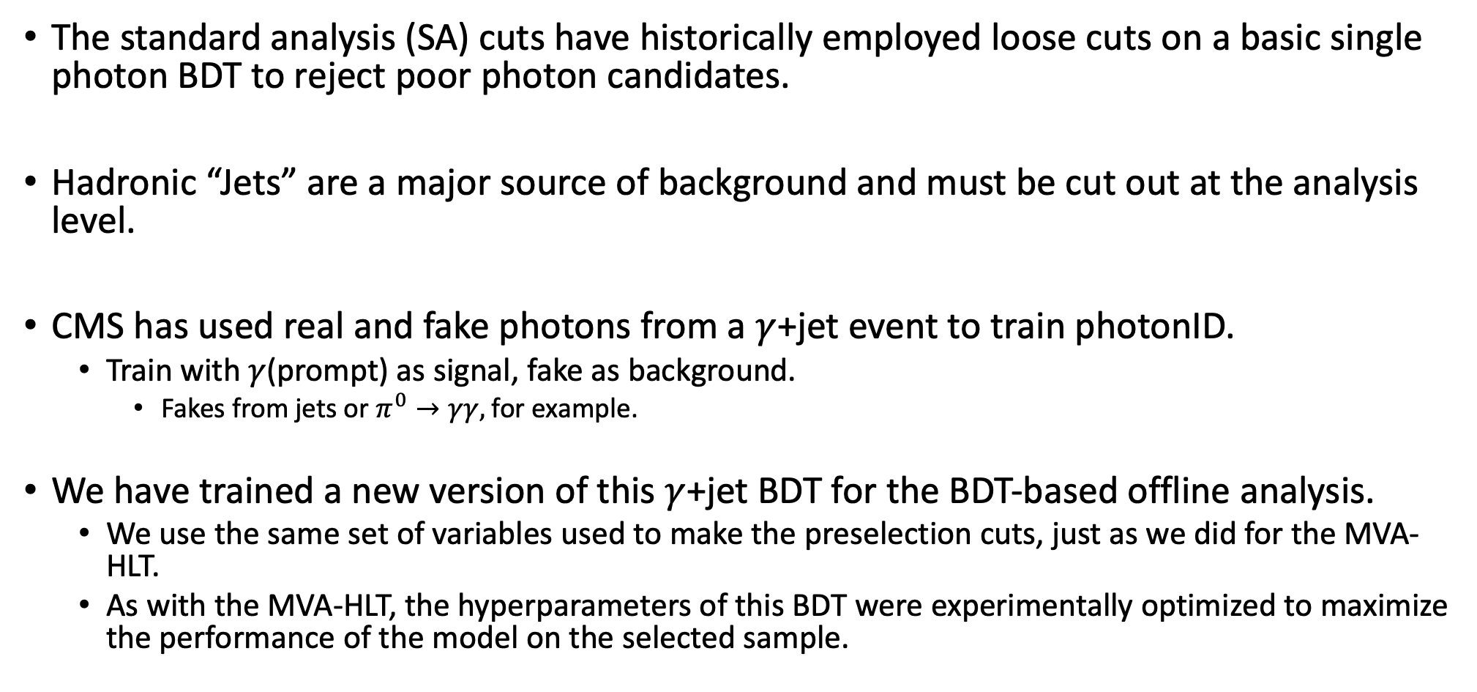

Offline $γ$+jet BDT
The standard analysis (SA) cuts have historically employed loose cuts on a basic single photon BDT to reject poor photon candidates.
Hadronic “Jets” are a major source of background and must be cut out at the analysis level.
CMS has used real and fake photons from a $γ$+jet event to train photonID.
  Train with $γ$(prompt) as signal, fake as background.
    Fakes from jets or $π^{0}→γγ,$for example.
We have trained a new version of this $γ$+jet BDT for the BDT-based offline analysis.
  We use the same set of variables used to make the preselection cuts, just as we did for the MVA-HLT.
  As with the MVA-HLT, the hyperparameters of this BDT were experimentally optimized to maximize the performance of the model on the selected sample.

Slide 30
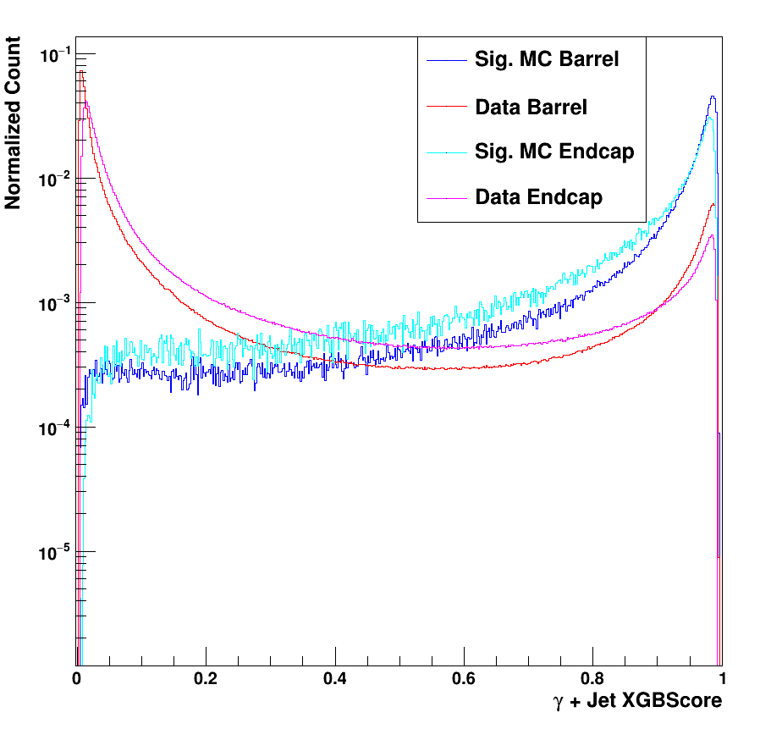

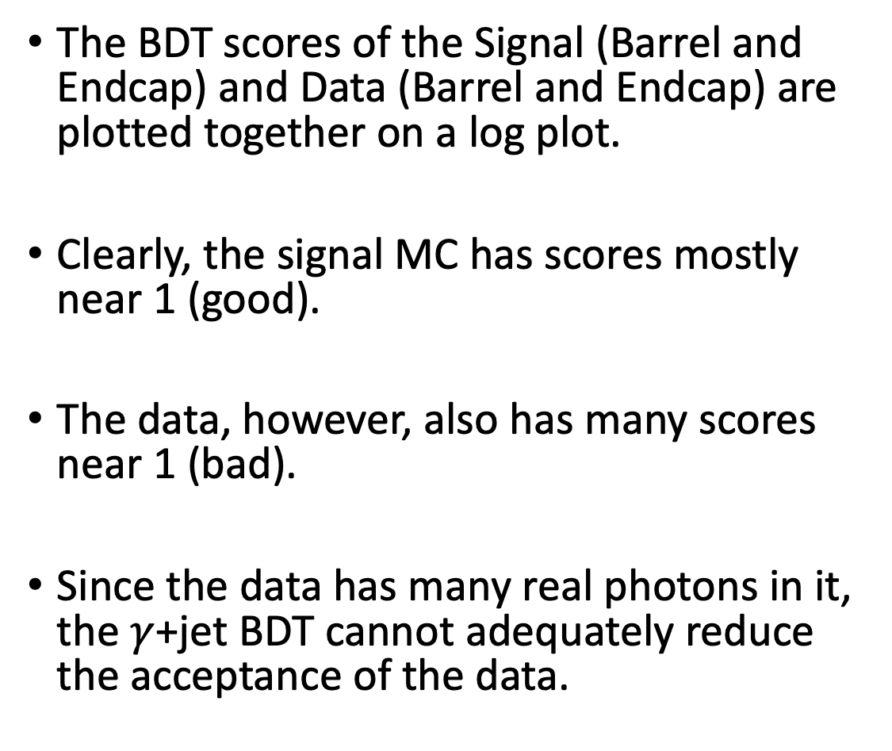
Single H $γ$+jet BDT Scores
The BDT scores of the Signal (Barrel and Endcap) and Data (Barrel and Endcap) are plotted together on a log plot.
Clearly, the signal MC has scores mostly near 1 (good).
The data, however, also has many scores near 1 (bad).
Since the data has many real photons in it, the $γ$+jet BDT cannot adequately reduce the acceptance of the data.

Slide 31
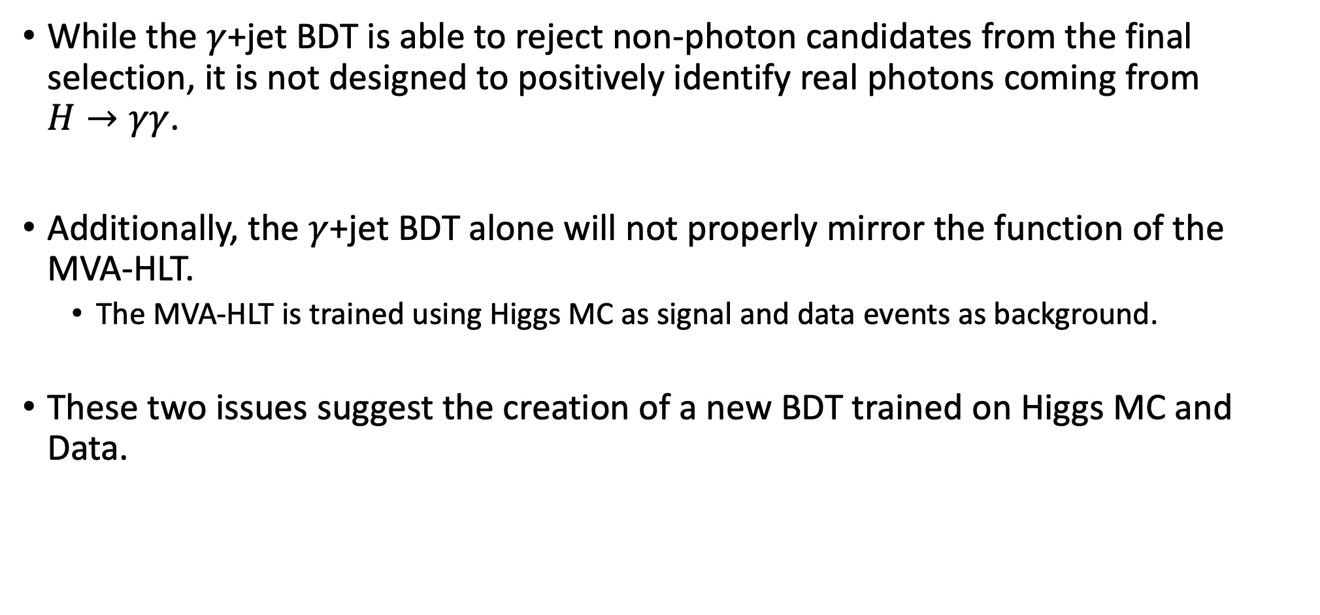
Offline Data/MC BDT
While the $γ$+jet BDT is able to reject non-photon candidates from the final selection, it is not designed to positively identify real photons coming from $H→γγ$.
Additionally, the $γ$+jet BDT alone will not properly mirror the function of the MVA-HLT.
  The MVA-HLT is trained using Higgs MC as signal and data events as background.
These two issues suggest the creation of a new BDT trained on Higgs MC and Data.

Slide 32
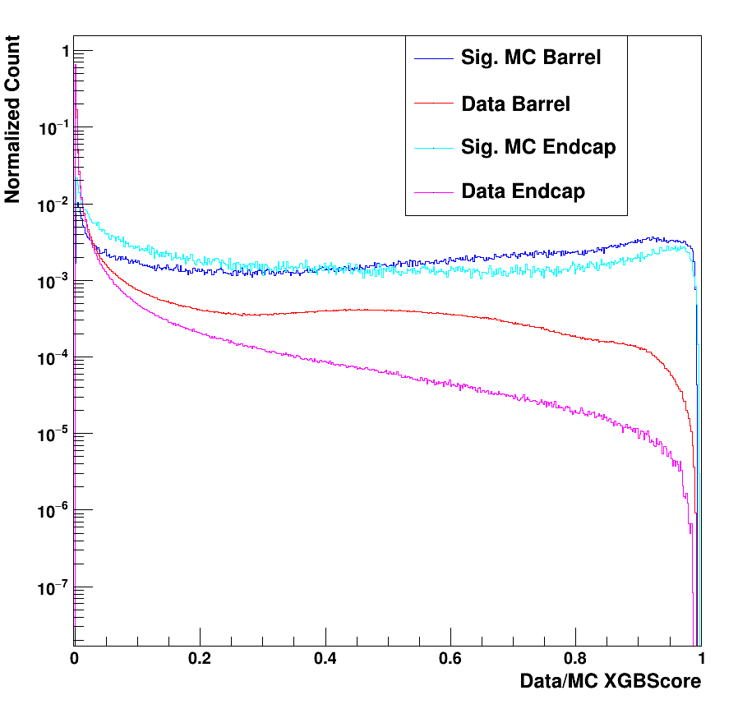

Single H Data/MC BDT Scores
The Data/MC shows the opposite issue to the $γ$+jet BDT; while the data is very well-localized near 0, there is still a lot of signal given a score close to 0.
Cutting too tight on this score will significantly reduce the signal efficiency.

Slide 33


Single Higgs Loose Single Photon BDT Cuts
Higgs MC Signal
Data
Instead of tight cuts on the single photon BDT scores, very loose cuts can be applied to significantly reduce the data rate while still keeping the signal efficiency very high (>98%).
Compared to the single photon Preselection and full Standard Analysis (SA) cuts, these loose single photon cuts have much higher signal efficiency but also accept more background.

Slide 34



DiHiggs $γ$+jet BDT Scores
The $γ$+jet BDT actually shows better separation for the DiHiggs than it did for the single Higgs.

Slide 35

DiHiggs Data/MC BDT Scores
Since the Data/MC BDT is trained using a specific signal MC sample, a new version was trained here for the DiHiggs signal MC.
This BDT seems to perform a bit better than the single Higgs version, with more signal approaching a score of 1.

Slide 36


DiHiggs Loose Single Photon BDT Cuts
DiHiggs MC Signal
Data
Instead of tight cuts on the single photon BDT scores, very loose cuts can be applied to significantly reduce the data rate while still keeping the signal efficiency very high (>98%).
Compared to the single photon Preselection and full Standard Analysis (SA) cuts, these loose single photon cuts have much higher signal efficiency but also accept more background.

Slide 37

Final Analysis Strategy – a Diphoton BDT
So far, both offline BDTs developed have been for selecting individual photon candidates.
The SA cuts, however, make cuts on the $p_{T}$/$M_{γγ}$, which is a diphoton quantity.
This suggests the creation of a BDT that uses information from both photons together to select events instead of individual photons – a diphoton BDT.
Run 2 analyses at CMS made use of a diphoton BDT for event categorization, so this marks a good starting point for the fully BDT-based approach.

Slide 38

Single H Diphoton BDT Scores
Much better separation between signal and data can be seen for the diphoton BDT than either single photon BDT.
A very loose cut on this score can clearly reduce the data rate considerably while still minimizing the loss of signal efficiency.
This new strategy leverages both single photon and diphoton information, mirroring the SA selection.

Slide 39

DiHiggs Diphoton BDT Scores
The separation for the DiHiggs is in fact considerably better than that of the single Higgs.
A very high signal efficiency is expected from cuts on this BDT score.

Slide 40

Full Offline Selection Results for
$H→γγ$ and $HH→b\overline{b}γγ$

Slide 41


Single Higgs $M_{γγ}$
Higgs MC Signal
Data
To compare to the Standard Analysis and Preselection cuts, diphoton BDT cuts must be chosen and optimized.
The Loosest cuts accept 2x as much background as the SA.
The Standard Selection cuts accept the same amount of background as the SA
The Tightest cuts accept ½ as much background as the SA.
These cuts are chosen as an example of an analysis strategy that preserves high signal efficiency, but each analysis has freedom to chose their own cuts.
With the same amount of background, the BDT-Based selection achieves a 29.4% gain in signal efficiency
The background mass distribution is affected by the SA cuts.

Slide 42


Single Higgs $M_{γγ}$
Higgs MC Signal
Data
The signal efficiency and data acceptance can be measured as the percent of the “All” curve accepted by each of the selections.
The overall efficiency of the signal is higher throughout the whole mass range for the BDT-cuts compared to both the preselection and the SA cuts.

Slide 43


Single Higgs $η_{SC}$
Higgs MC Signal
Data
As with the sHLT, the presel and SA cuts reduce the efficiency of the signal at the lower-eta region of the endcap.
The BDT-based selections all tend to accept less data in the higher-eta region of the endcap.
In addition to the overall improvement to signal efficiency, the kinematic coverage is improved by the BDT-based offline selection.

Slide 44


Single Higgs $η_{SC}$
Higgs MC Signal
Data
The inefficiencies of the SA cuts are clearer here.
The BDT-based selection keeps relatively flat efficiency throughout the selected $η_{SC}$ range.

Slide 45




Single Higgs $p_{T}$/$M_{γγ}$
Higgs MC Signal
Data
The SA cuts on $p_{T}$/$M_{γγ}$ are helpful for controlling the background, but also clearly reduce the signal efficiency considerably.
By using the diphoton BDT scores instead of hard cuts on the $p_{T}$/$M_{γγ}$, the BDT-based approach is able to further Improve the kinematic coverage of the offline selection.

Slide 46



Single Higgs $p_{T}$/$M_{γγ}$
Higgs MC Signal
Data
The Presel and SA cuts both reject not only low- $p_{T}$/$M_{γγ}$ photons, but also reduce the efficiency at higher values.
The efficiency of the BDT-based approach is relatively flat above $p_{T}$/$M_{γγ}$ = 0.4.

Slide 47





Single Higgs Diphoton $p_{T}$
Higgs MC Signal
Data
For the single Higgs sample, the diphoton $p_{T}$ of the signal MC is relatively similar to that of the data.
This variable will be more interesting for the DiHiggs sample.
Neither set of selections noticeably leverages the single Higgs diphoton $p_{T}$ to make a selection.

Slide 48



Single Higgs Diphoton $p_{T}$
Higgs MC Signal
Data
A
Again, the BDT-based selection has a flatter efficiency across the whole range of diphoton $p_{T}$.

Slide 49


DiHiggs $M_{γγ}$
DiHiggs MC Signal
Data
The DiHiggs mass distribution is relatively similar for both the signal MC and data.
The overall signal efficiency is improved for the DiHiggs (94.7%) compared to the Single Higgs (91.3%).
With the same amount of background, the BDT-Based selection achieves a 39.7% gain in signal efficiency.
The BDT-based selection works well for the DiHiggs.

Slide 50


DiHiggs $M_{γγ}$
DiHiggs MC Signal
Data
A
A

Slide 51




DiHiggs $η_{SC}$
DiHiggs MC Signal
Data
Similar features can be noted compared to the Single Higgs $η_{SC}$.
Note that there are fewer DiHiggs photon candidates in the endcap relative to the single Higgs.
Again, the kinematic coverage of the BDT-based selection is better than that of the standard analysis selection in $η_{SC}$

Slide 52


DiHiggs $η_{SC}$
DiHiggs MC Signal
Data
A
A

Slide 53




DiHiggs $p_{T}$/$M_{γγ}$
DiHiggs MC Signal
Data
The $p_{T}$/$M_{γγ}$ distribution for the DiHiggs signal tends to extend to higher values than that of the single Higgs.
  Due to the kinematics of having two Higgs produced, which are often back-to-back in the center of mass frame.
The hard $p_{T}$/$M_{γγ}$ cuts still greatly affect the signal efficiency of the SA cuts, so removing them both increases the kinematic coverage and improves the overall signal efficiency considerably.

Slide 54


DiHiggs $p_{T}$/$M_{γγ}$
DiHiggs MC Signal
Data
A
A

Slide 55




DiHiggs Diphoton $p_{T}$
DiHiggs MC Signal
Data
Clearly, the Diphoton $p_{T}$ of the DiHiggs is quite different from that of the Single Higgs, extending to considerably higher values.
  Since two Higgs are produces back-to-back, each one is more likely to have high $p_{T}$.
In the data, the BDT-based selections are clearly biased towards accepting higher values of Diphoton $p_{T}.$
A

Slide 56
DiHiggs Diphoton $p_{T}$
DiHiggs MC Signal
Data
A
A

Slide 57


Offline Selection Efficiency Summary
Single Higgs
Huge gains are achieved at the selection level for both the single and DiHiggs signal MC.
The gains are largest for events where one or both photons are in the barrel, showing the increase in kinematic coverage.
A selection efficiency above 90% with greatly benefit both single and DiHiggs analyses.
$η_{SC}$ Region | SA Efficiency | BDT Efficiency | Efficiency Gain
B-B | 81.95 | 94.56 | +15.4
B-E | 52.12 | 85.43 | +63.9
E-E | 63.63 | 91.63 | +44.0
ALL | 70.53 | 91.27 | +29.4
DiHiggs
$η_{SC}$ Region | SA Efficiency | BDT Efficiency | Efficiency Gain
B-B | 73.43 | 97.23 | +32.4
B-E | 53.83 | 88.38 | +64.2
E-E | 57.02 | 89.88 | +57.6
ALL | 67.78 | 94.68 | +39.7

Slide 58

Conclusions
A new BDT-based approach has been developed to improve the HLT and offline selection for $H→γγ$ events at the CMS experiment.
The MVA-HLT is able to improve the signal efficiency of both $H→γγ$ and $HH→b\overline{b}γγ$ MC samples while still cutting the rate of accepted data almost in half.
The complementary offline selection is able to improve the signal efficiency by 29% for the single Higgs and 39% for the DiHiggs compared to the standard analysis cuts.
Looking forward, this new HLT and offline selection may prove a vital boon to future analyses, especially those targeting rare decays that include a $H→γγ$.

